Slide 1
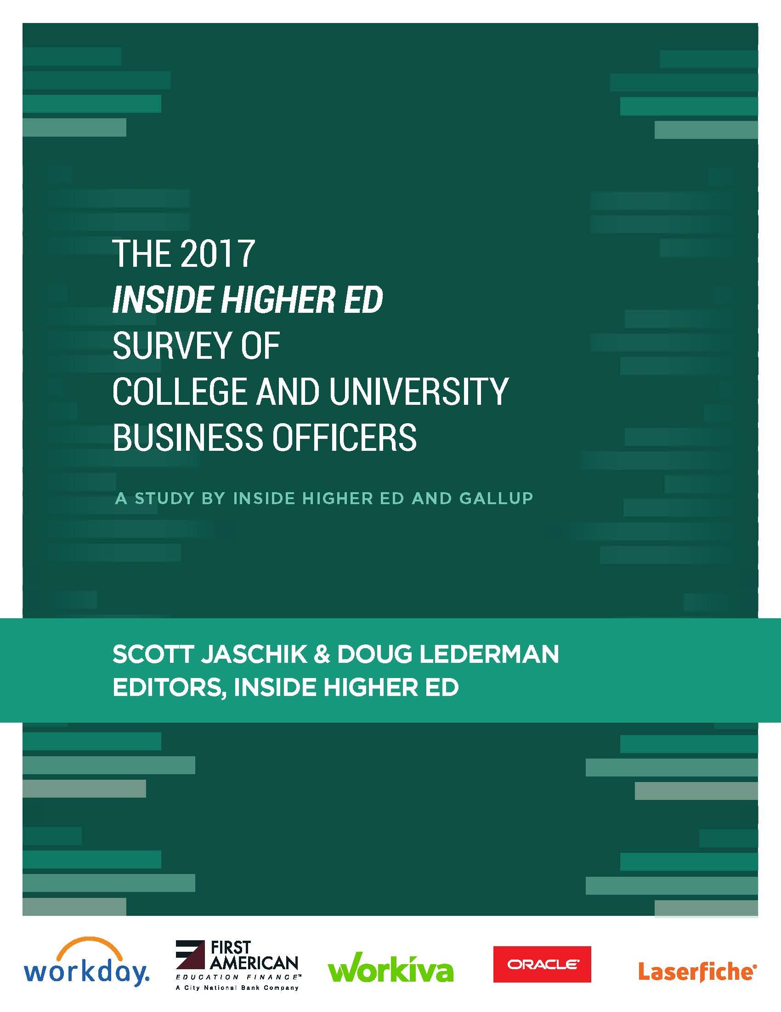
The 2017 Survey of College and University Business Officers
An Inside Higher Ed webinar Tuesday, Aug. 8, 2 p.m. EDT

Slide 2
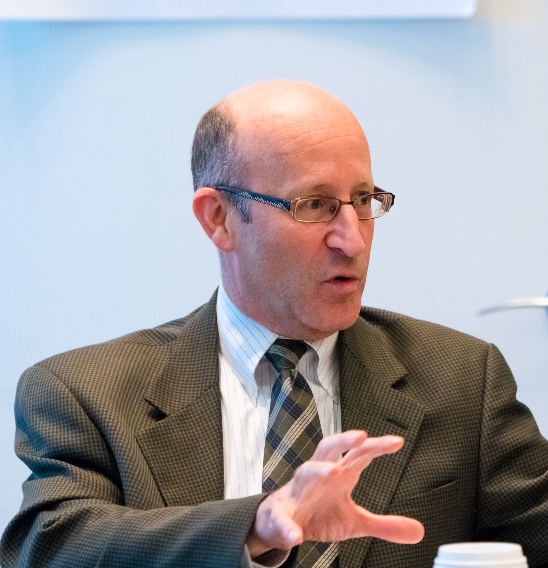
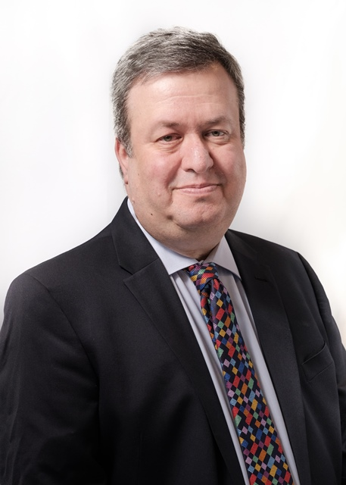
Presenters
Doug Lederman, editor, Inside Higher Ed
Scott Jaschik, editor Inside Higher Ed

Slide 3
Methodology
Questions prepared by Inside Higher Ed, in collaboration with Gallup.
Polling conducted by Gallup in May/June.
Results from 409 chief business officers.
Complete anonymity for respondents, but answers coded to allow for breakdown by sector, etc.

Slide 4
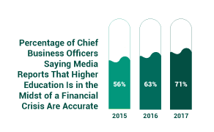
A Financial Crisis for Higher Ed?...
Increasing numbers think so:

Slide 5
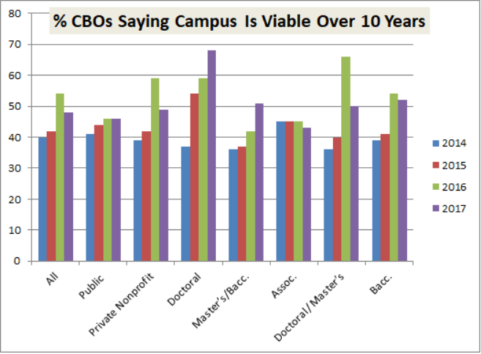
…And for My Own Institution?
Less confident this year than last, but more than in 2015.
Si Significant variation by sector.

Slide 6
Responses to Financial Pressures
2/3 agree/strongly agree new spending will come from reallocated revenue.
Fewer than in past counting on growth in enrollment (71% vs. 87% in 2016).
Ebbing confidence in strategies for new revenue:
 | 2015 | 2016 | 2017
Increase overall enrollment | 82% | 87% | 71%
Launch new revenue-generating programs | 70% | 71% | 68%
Explore collaboration opportunities for academic programs with other institutions | 62% | 65% | 63%

Slide 7
Responses to Financial Pressures (cont.)
Growing interest in some kinds of cost reduction:
 | 2015 | 2016 | 2017
Cut underperforming academic programs | 38% | 43% | 50%
Promote early retirement for admins/staff | 22% | 17% | 31%
Promote early retirement for faculty | 33% | 27% | 38%
Increase teaching loads for f-t faculty | 26% | 32% | 35%
Reduce administrative positions | 37% | 35% | 44%
Cut spending to intercollegiate athletics | 15% | 11% | 20%

Slide 8
No Merger Mania
12% of CBOs say institution has had “serious internal discussions” in last year about merging with another college. Highest (21%) at private doctoral/master’s institutions, lowest at private baccalaureate (5%).
24% say institution has had “serious internal discussions” in last year about consolidating some programs with another college.
 | Will It? | Should It?
Merger within 3 years | 9% | 16%
Share back-office functions | 34% | 54%
Combine academic programs | 33% | 58%

Slide 9
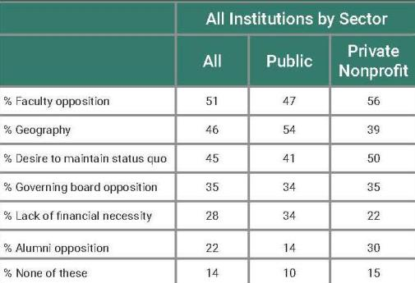
No Merger Mania (cont.)
Impediments to merging or consolidating?

Slide 10
Transparency’s Time?
General agreement that transparency in campus decision-making leads to better financial decisions.
How transparent? 33% excellent, 45% good, 18% fair, 3% poor. Public doctoral least transparent, community colleges most.
“Extensive information” about financial health widely shared with governing board and faculty leaders (90% plus), full faculty and staff (70%), less so with other constituents (under 50%).
Fewer than a third of campuses involve full faculty and staff in developing budget proposals.

Slide 11
The Faculty Role
 | Public | Private
Do faculty play meaningful role in budget decisions? | 53% | 38%
Should faculty play meaningful role in college-wide budget decisions? | 16% 42% | 19% (strongly) 37% (agree)
Faculty approval required for new revenue strategies? | 45% | 67%
Should faculty approval be required for revenue strategies? | 9% | 20% (strongly)
Faculty members understand financial challenges my institution faces. | 4% 22% | 6% (strongly) 32% (agree)
Note: % = proportion who strongly agree or agree
Notes:
Much more confidence in other constituents … Those numbers stand in stark contract to the CBOs' views about other campus constituents. Seventy-seven percent of business officers said trustees "are aware of and understand the financial challenges confronting my institution," and 85 percent said the same about senior administrators. Two-thirds said the chief academic officer on their campus was a "productive partner" in creating a financially sustainable business model.

Slide 12
Retention and Financial Sustainability
Institutions have invested heavily in clearly designed pathways for degrees (83%), academic coaching (78%), training of faculty (74%).
Vast majority (86%) said they had invested assuming increased financial sustainability.
38% said they’ve seen such a return.
12% said no return.
50% too early to be determined.

Slide 13
The Trump Effect
Which potential federal changes/ cutbacks are most concerning?
Reductions in federal financial aid: worries everyone “a great deal” (80%), especially community colleges.
Immigration policies: 21% of all CBOs greatly concerned, but 45% of those at public doctoral universities.
Cutbacks in federal research grants: 11% all, 82% public doctoral.
Cutbacks in federal research overhead rates: 10% all, 79% public doctoral.

Slide 14
Other Highlights
Private college CBOs (49%) are more likely than public university peers (23%) to agree that tuition discount rate is unsustainable.
73% describe institutions’ debt levels as appropriate; 12% believe they have too much debt, 15% say they should add debt.
Endowment payout rates: 71% said they would keep steady. 3% said they expected to raise rates, 27% to lower them
CBOs are evenly split on whether sustainability efforts at their institutions “have provided significant financial benefits.

Slide 15
More Information/Contact
Doug Lederman, editor, Inside Higher Ed
doug.lederman@insidehighered.com
Scott Jaschik, editor, Inside Higher Ed
scott.jaschik@insidehighered.com
Survey article:
https://www.insidehighered.com/news/survey/survey-finds-business-officers-increasingly-considering-more-painful-options
Download survey report:
https://www.insidehighered.com/booklet/2017-survey-college-and-university-business-officers

Slide 16
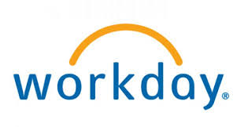
Thanks to Survey Sponsors

